Slide 1
Self-Esteem of a Muslim
The Inspiring Legacy of Nusaybah bint Ka’ab (RA)
Task 8
Presenter / Captain : Farida Mughal
Group 6 CM18
Community Head: Mahrukh & Haseeb

Slide 2

Self-esteem
‘Self esteem is the gravity on which we value and appreciate our individual and collective abilities, based on our faith.’

Slide 3
Self-esteem of a Muslim
Eman Increases & Decreases
Self-esteem goes High & Low
A Muslim’s Eman increases with the acts of Obedience to Allah SWT and Decreases with the acts of Disobedience.
We have to have a strong Conviction in our Heart, say it from our Tongue and show it from our Actions.
Eman directly connected to the Self-esteem.
As Eman increases, our Self-esteem goes High and as Eman decreases, our Self-esteem goes low.

Slide 4
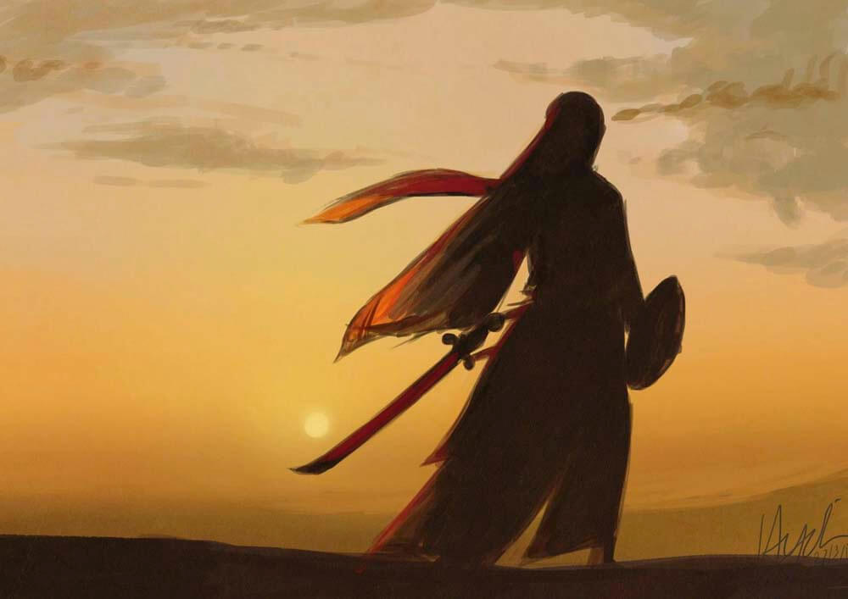
Nusaybah bint Ka’ab (RA): Embodying High Self-Esteem and Faith in Islam (Image ref: womeninislam1.wordpress.com)

Slide 5
Quotes by the Scholars
Ali Al-Shawkani, M(2006).
Imam Ibn Hajar Al-Asqalani
Qassem, H. Umm’ Umara: The Prophet’s Shield at Uhud
“Umm’ Umarah took part in the pledge of Al-Aqabah and witnessed it. She participated in battles of Uhud, Khaybar, Hunayn and Yamamah. She was present at Hudaybiyah and ‘Umrah Al-Qadaa.’ Umm’ Umarah witnessed the victory of Makkah. Her presence at the most important battles and events are highly appreciated more than that of the other women.”
“Nusaybah RA took the sword and a shield to protect Nabi s.aw when there was havoc in the battle field of Uhud. The Messenger of Allah stated that ‘Whenever I turned to the left or right, I saw her (Nusaybah) fighting for me.’ Nusaybah RA heard the news that her son Habib was murdered by Musaylama (when sent as ambassador of Nabi s.aw) vowed to kill him. Finally in the battle of Yamamah, Nusaybah RA and her son Abdullah killed Musaylamah when he was injured. His son was martyred and one of her arm was cut off in this battle.”
“Nusaybah bint Ka’ab / Umm’ Umara took part in Jihad (fighting with sword / Weapon) for the cause of Allah. She considered Woman and a Man are both equally responsible to defend the religion of Islam. Nusaybah RA took part in the battle of Uhud, Hunayn and was present at the Treaty of Hudaybiyah.”

Slide 6
Nusaybah bint Ka’ab RA
Um Amarah
A Warrior Sahabiyah, a Symbol of High Level of Eman and Taqwa, reflected in her unmatched Self-esteem resultantly Chosen by Allah SWT to be the Companion of Nabi S.A.W (Salallaho Alaihi Wasallam) in Junnah
Nusaybah RA (RadeyAllahu Anha) was called ‘Um Amarah’ and she believed that women had the same right as men to fight for Allah’s cause.

Slide 7
Lineage
 |  | Yathrib / Madina Bani Khazraj Banu Mazin Tribe
 |  | Ka’ab bin Amr RA (Father) Rubab bint AbdAllah RA (Mother)
AbduRehaman bin Ka’ab RA (Son) | AbdAllah bin Ka’ab RA (Son) |  | Nusaybah bint Ka’ab RA (Daughter) Zaid bin Asim (1st Husband from Banu Najjar) | Guziya bin Amr (2nd Husband from Banu Najjar)
 |  |  | Son: AbdAllah bin Zaid Son: Habib bin Zaid | Son: Tamim Daughter: Khaulah

Slide 8
Um Amarah was amongst the 72 people who went to Makkah from Madinah for Allegiance in Aqabah
Pledge of Aqabah

Slide 9
On the day of Uhad, (23 March, 625 AD) Um Amarah along with other Sahabiyat including Aisha RA and Fatima RA were offering water to the thirsty soldiers and dressing the wounded. Her Husband Guziya bin Amr and sons Abdullah and Habib were fighting close to Nabi s.aw.
More than 70 companions were injured and many were martyred in the battle of Uhad
Day of Uhad

Slide 10
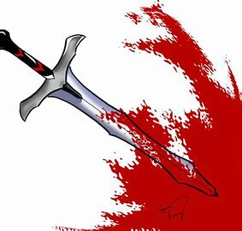
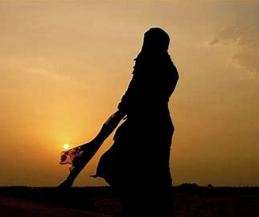
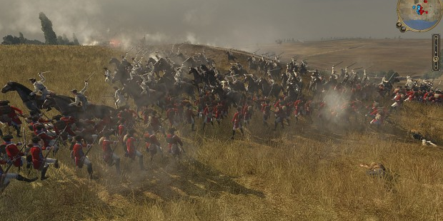
Son and Mother Injured
Son Injured
Mother Injured
All Family was Fighting
Um Amarah’s son was struck and bleeded, she bandaged and wrapped him saying ‘Get up, go and fight.'
Later she was wounded and Nabi s.aw called her son saying ‘Your mother, Your mother' and then the son dressed her mother's wounds and she resumed fighting.
Um Amarah’s two sons and Husband were already fighting by the side of Nabi s.aw when she joined them.

Slide 11
Nabi s.a.w Highly Appraised Um Amarah
Sudden Transformation of a Great Fighter
A Better Fighter
Shield of Nabi s.a.w
Courageous
“Um Amarah was a better fighter than so and so”
“When I looked to my right, I saw Nusaybah, when I looked to my left, I saw Nusaybah, when I looked to my front, I saw Nusaybah.”
“From where can anyone get the courage like you 'O Um Amarah?” Nabi s.a.w complemented.

Slide 12
Nabi s.aw highly praised Um Amarah RA and her family. She requested Nabi s.aw to make duaa that Allah SWT make herself and her family Nabi s.aw’s Companion in Junnah. Nabi s.aw made this duaa then and there. Um Amarah RA was very happy and said: “Now I have no worries whatsoever happens to me in this duniya.”
Glad Tidings for Um Amarah

Slide 13
Narrator of Hadith https://islamicbridge.com/2019/12/Nusaybah-bint-kaab-the-first-womenwarrior-of-islam/
Fasting Person
A Strong Advocate
No Handshaking
“The Messenger of Allah (saw) came to my house and I brought food for him. Nabi s.aw asked me “Eat” I replied, “I am fasting.” Nabi s.aw said: ‘If the food is eaten in the house of a fasting person, the angels sends blessing upon him.”
1-Al- Masnad Lil-Imam Ahmed bin Muhammad bin Hanbal Hadith No 27345, page 560
One day, Um Amarah went to Nabi s.aw and enquired about the reason why the Qur’an did not refer to women as most of the verses are related to men.
Allah SWT revealed the ayahs 33-35 of Surah Al-Ahzab to the Nabi s.aw.
1-Sahih o Daeef Sunan Al-Tirmidhi Imam Nasir ud Deen Al-Bani No 3211, page 948
At the time of pledge of Aqabah, Um Amarah’s Husband Gaziya bin Amr informed Nabi s.aw that the women also came for the pledge and Nabi s.aw agreed and informed that he will not have ths.awr hands in his as he had done with men.
1- Al-Asabah fi Tumyeez Al-Sahabah Al-Imam Ahafiz Ahmed bin Ali bin Hajar Al-asqalani No 12276, page 481- 482

Slide 14
Vision and Purpose of Life
Um Amarah’s Sacrifices were distinctly recognized that she love Allah and Nabi s.aw more than herself, her children, family and wealth in the cause of Islam.
Resultantly, she earned Junnah, her goal, she was aspiring in this world.
Um Amarah proved herself a fearless, selfless, courageous, compassionate, dignified and dedicated individual and astonished those who saw her fighting.
She was a great example for the Generations to come.

Slide 15
Nabi s.aw sent Um Amarah’s son Habib RA and another Sahabi to Musaylamah the liar who claimed prophethood. When Habib RA delivered the message, Musaylamah asked him: “Do you testify that Muhammed is the Messenger of Allah?” Habib RA replied ‘ Yes’. Then he asked: “Do you testify that I am the messenger of Allah?” He replied, “I can’t hear you.” Musaylama asked this question three time and Habib’s answer was the same. Musaylamah started cutting Habib’s body parts till his soul flew to his eternal abode.
Great Test for Um Amarah

Slide 16
Nabi s.aw was greatly touched with the brutal act of Musaylama the liar regarding Habib’s shahadah.
Nabi s.aw went to Um Amarah to break the news along with Umar RA and Abubakar Siddique RA.
The great mother Um Amarah stated: “When he was little he gave allegiance to Nabi s.aw and today, at his young age, he fulfilled his promise.”
Exemplary Patience

Slide 17
Um Amarah RA played a great role in the community during the wars and otherwise. She was performing Humanitarian work in the battle ground and rallying the Islamic forces. She boosting ths.awr morale and quenching ths.awr thirst by offering them water and dressing ths.awr wounds. She was dedicated to the cause of community.
During the period of peace, Um Amarah began to teach Islam to the women of the city of Madina. Many of the Sahabah were approaching Um Amarah to learn about the events where she herself was present and witnessed.
She was a Nurse and a Fighter in the battle field and an Inspirational Teacher of Hadith and Qura’an at peace.
Role in the Community

Slide 18
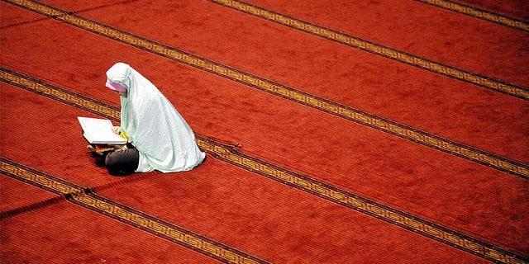
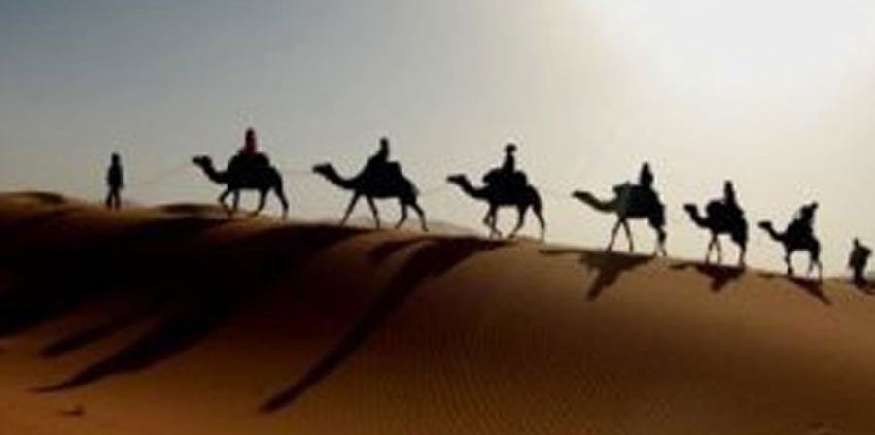
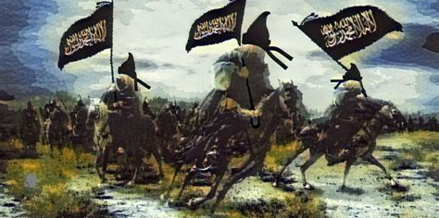
Major Achievements
First few to Embrace Islam
Went to Bayah ul Aqabah
Fought Battle of Uhad and more
Mus'ab bin Umair called people of Madina on the true Deen of Islam, Um Amarah was amongst the first few to embrace Islam.
Later she went to Aqabah for allegiance to Allah and Nabi s.aw amongst 72 men and 2 women from Madina
In Uhad, her conduct was marvellous. Thereafter, she took part in Khayber, Hunayn and fought brilliantly in Yamamah.

Slide 19
Summery of Characteristics
A great role model
Fearless Fighter
Glorious Warrior (Uhad, Khayber, Hunayn and Yamama)
Recs.awved many injuries and lost one arm.
Quick learner to use sword and a shield in the battle of Uhad
Used excellent strategies to bring down the enemy
First to embrace Islam
Participated in the Pledge of Aqabah
Narrator of Hadith
Brilliant Teacher
Excellent Nurse
Dedicated Community person
Determined to take revenge
5- Never gave up
A Unique and distinguished personality
Blunt and straightforward
Sincere
Courageous
Charitable
Confident
Resilient
Accepts Challenges
Faithful and loyal wife
Loving Mother

Slide 20
Later in life, Um Amarah RA came to Nabi S.A.W and stated: “All the rewards are for men by Allah SWT in Quran, where we women stand? Why is there no mention of us?”
And then Allah SWT revealed the beautiful verses 33-35 of surah Al-Ahzab.
Sahih o Daeef Sunan Al-Tirmidhi Imam Nasir ud Deen Al-Bani No 3211, page 948
Revelation by Allah SWT

Slide 21
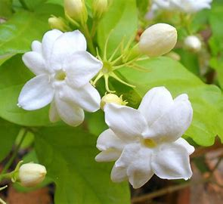
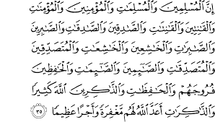
“ Surely for Muslim men and women, believing men and women, truthful men and women, patient men and women, humble men and women, charitable men and women, fasting men and women, men and women who guard ths.awr chastity and men and women who remember Allah often- for all of them Allah has prepared forgiveness and a great reward.” Surah Al-Ahzab verse 33-35

Slide 22
After the battle of Uhad, Um Amarah RA fought nearly all the battles and wars leaving an exemplary precedent of High Self-esteem for the generations to come.
She died in 13 Hijri in Madina and was buried in Junnat ul Baqih
Last Days

Slide 23
References
Al-Asaabah fi Tamyeez Al-Sahabah Lil-Imam Al-Hafiz Ahmed bin Ali bin Haja Al-Asqalaani No 12276, page 481-482
Al-Masnad Lil-Imam Ahmen bin Muhammad bin Hanbal No 27345, page 560
Sahih o Daeef Sunan Al-Tirmizi Al-Imam Nasir ud Deen Al-Baani
https://islamicbridge.com/2019/12/Nusaybah-bint-kaab-the-first-womenwarrior-of-islam/

Slide 24
THANKS FOR WATCHING!
Any questions?

